Slide 1
Lecture week 2 Artificial Intelligence
Engr.Faiz ul haque Zeya
Senior Associate professor Software engineering department,BUKC

Slide 2
Today’s topics
Types of AI.
Turing test.
Nature of environment
Multiagent system
Distributed AI
AAAI.org introduction The 100 Most Influential People in AI 2023 | TIME

Slide 3
Type of AI (By definition)
System that think rationally
System that think like human
System that acts like human
System that acts rationally.

Slide 4
Thinking humanly: Cognitive Science
1960s “cognitive revolution”: information-processing psychology replaced prevailing orthodoxy of behaviorism
Requires scientific theories of internal activities of the brain – What level of abstraction? “Knowledge” or “circuits”?
– How to validate? Requires
1) Predicting and testing behavior of human subjects (top-down) or 2) Direct identification from neurological data (bottom-up)
Both approaches (roughly, Cognitive Science and Cognitive Neuroscience) are now distinct from AI

Slide 5
Thinking rationally: Laws of Thought
Normative (or prescriptive) rather than descriptive Aristotle: what are correct arguments/thought processes?
Several Greek schools developed various forms of logic:
notation and rules of derivation for thoughts;
may or may not have proceeded to the idea of mechanization Direct line through mathematics and philosophy to modern AI

Slide 6
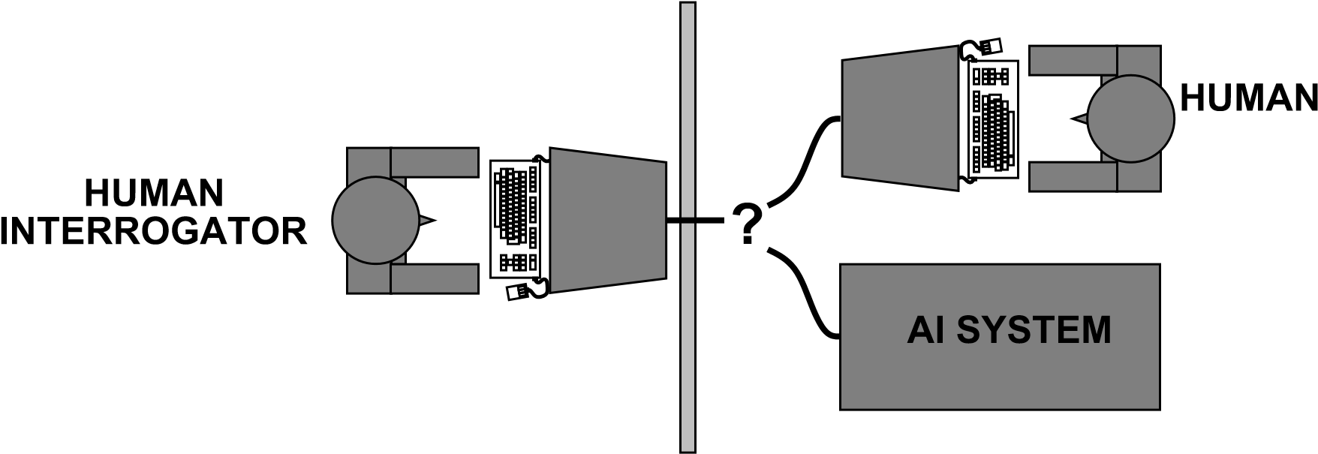
Acting humanly: The Turing test
Turing (1950) “Computing machinery and intelligence”:
♦ “Can machines think?” −→ “Can machines behave intelligently?”
♦ Operational test for intelligent behavior: the Imitation Game
♦ Predicted that by 2000, a machine might have a 30% chance of fooling a lay person
for 5 minutes
♦ Anticipated all major arguments against AI in following 50 years
♦ Suggested major components of AI: knowledge, reasoning, language understanding
, learning

Slide 7
Multiagent systems

Slide 9
Overview
Five ongoing trends have marked the history of computing:
ubiquity;
interconnection;
intelligence;
delegation; and
human-orientation

Slide 10
Ubiquity
The continual reduction in cost of computing capability has made it possible to introduce processing power into places and devices that would have once been uneconomic
As processing capability spreads, sophistication (and intelligence of a sort) becomes ubiquitous
What could benefit from having a processor embedded in it…?

Slide 11
Interconnection
Computer systems today no longer stand alone, but are networked into large distributed systems
The internet is an obvious example, but networking is spreading its ever-growing tentacles…
Since distributed and concurrent systems have become the norm, some researchers are putting forward theoretical models that portray computing as primarily a process of interaction

Slide 12
Intelligence
The complexity of tasks that we are capable of automating and delegating to computers has grown steadily
If you don’t feel comfortable with this definition of “intelligence”, it’s probably because you are a human

Slide 13
Delegation
Computers are doing more for us – without our intervention
We are giving control to computers, even in safety critical tasks
One example: fly-by-wire aircraft, where the machine’s judgment may be trusted more than an experienced pilot
Next on the agenda: fly-by-wire cars, intelligent braking systems, cruise control that maintains distance from car in front…

Slide 14
Human Orientation
The movement away from machine-oriented views of programming toward concepts and metaphors that more closely reflect the way we ourselves understand the world
Programmers (and users!) relate to the machine differently
Programmers conceptualize and implement software in terms of higher-level – more human-oriented – abstractions

Slide 15
Programming progression…
Programming has progressed through:
machine code;
assembly language;
machine-independent programming languages;
sub-routines;
procedures & functions;
abstract data types;
objects;
to agents.

Slide 16
Global Computing
What techniques might be needed to deal with systems composed of 10¹⁰ processors?
Don’t be deterred by its seeming to be “science fiction”
Hundreds of millions of people connected by email once seemed to be “science fiction”…
Let’s assume that current software development models can’t handle this…

Slide 17
Where does it bring us?
Delegation and Intelligence imply the need to build computer systems that can act effectively on our behalf
This implies:
The ability of computer systems to act independently
The ability of computer systems to act in a way that represents our best interests while interacting with other humans or systems

Slide 18
Interconnection and Distribution
Interconnection and Distribution have become core motifs in Computer Science
But Interconnection and Distribution, coupled with the need for systems to represent our best interests, implies systems that can cooperate and reach agreements (or even compete) with other systems that have different interests (much as we do with other people)

Slide 19
So Computer Science expands…
These issues were not studied in Computer Science until recently
All of these trends have led to the emergence of a new field in Computer Science: multiagent systems

Slide 20
Agents, a Definition
An agent is a computer system that is capable of independent action on behalf of its user or owner (figuring out what needs to be done to satisfy design objectives, rather than constantly being told)

Slide 21
Multiagent Systems, a Definition
A multiagent system is one that consists of a number of agents, which interact with one-another
In the most general case, agents will be acting on behalf of users with different goals and motivations
To successfully interact, they will require the ability to cooperate, coordinate, and negotiate with each other, much as people do

Slide 22
Agent Design, Society Design
The course covers two key problems:
How do we build agents capable of independent, autonomous action, so that they can successfully carry out tasks we delegate to them?
How do we build agents that are capable of interacting (cooperating, coordinating, negotiating) with other agents in order to successfully carry out those delegated tasks, especially when the other agents cannot be assumed to share the same interests/goals?
The first problem is agent design, the second is society design (micro/macro)

Slide 23
Multiagent Systems
In Multiagent Systems, we address questions such as:
How can cooperation emerge in societies of self-interested agents?
What kinds of languages can agents use to communicate?
How can self-interested agents recognize conflict, and how can they (nevertheless) reach agreement?
How can autonomous agents coordinate their activities so as to cooperatively achieve goals?

Slide 24
Multiagent Systems
While these questions are all addressed in part by other disciplines (notably economics and social sciences), what makes the multiagent systems field unique is that it emphasizes that the agents in question are computational, information processing entities.

Slide 25
The Vision Thing
It’s easiest to understand the field of multiagent systems if you understand researchers’ vision of the future
Fortunately, different researchers have different visions
The amalgamation of these visions (and research directions, and methodologies, and interests, and…) define the field
But the field’s researchers clearly have enough in common to consider each other’s work relevant to their own

Slide 26
Spacecraft Control
When a space probe makes its long flight from Earth to the outer planets, a ground crew is usually required to continually track its progress, and decide how to deal with unexpected eventualities. This is costly and, if decisions are required quickly, it is simply not practicable. For these reasons, organizations like NASA are seriously investigating the possibility of making probes more autonomous — giving them richer decision making capabilities and responsibilities.
This is not fiction: NASA’s DS1 has done it!

Slide 27
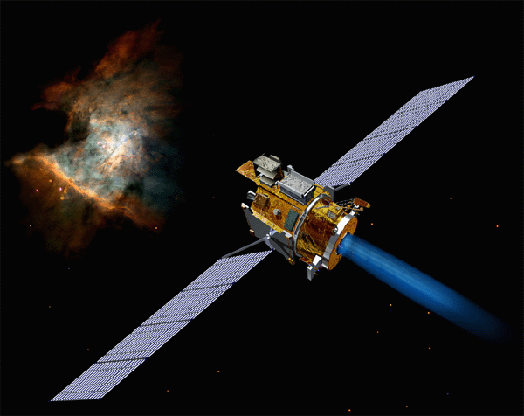
Deep Space 1
http://nmp.jpl.nasa.gov/ds1/
“Deep Space 1 launched from Cape Canaveral on October 24, 1998. During a highly successful primary mission, it tested 12 advanced, high-risk technologies in space. In an extremely successful extended mission, it encountered comet Borrelly and returned the best images and other science data ever from a comet. During its fully successful hyperextended mission, it conducted further technology tests. The spacecraft was retired on December 18, 2001.” – NASA Web site

Slide 28
Autonomous Agents for specialized tasks
The DS1 example is one of a generic class
Agents (and their physical instantiation in robots) have a role to play in high-risk situations, unsuitable or impossible for humans
The degree of autonomy will differ depending on the situation (remote human control may be an alternative, but not always)

Slide 29
Air Traffic Control
“A key air-traffic control system…suddenly fails, leaving flights in the vicinity of the airport with no air-traffic control support. Fortunately, autonomous air-traffic control systems in nearby airports recognize the failure of their peer, and cooperate to track and deal with all affected flights.”
Systems taking the initiative when necessary
Agents cooperating to solve problems beyond the capabilities of any individual agent

Slide 30
Internet Agents
Searching the Internet for the answer to a specific query can be a long and tedious process. So, why not allow a computer program — an agent — do searches for us? The agent would typically be given a query that would require synthesizing pieces of information from various different Internet information sources. Failure would occur when a particular resource was unavailable, (perhaps due to network failure), or where results could not be obtained.

Slide 31
What if the agents become better?
Internet agents need not simply search
They can plan, arrange, buy, negotiate – carry out arrangements of all sorts that would normally be done by their human user
As more can be done electronically, software agents theoretically have more access to systems that affect the real-world
But new research problems arise just as quickly…

Slide 32
Research Issues
How do you state your preferences to your agent?
How can your agent compare different deals from different vendors? What if there are many different parameters?
What algorithms can your agent use to negotiate with other agents (to make sure you get a good deal)?
These issues aren’t frivolous – automated procurement could be used massively by (for example) government agencies
The Trading Agents Competition…

Slide 33
Multiagent Systems is Interdisciplinary
The field of Multiagent Systems is influenced and inspired by many other fields:
Economics
Philosophy
Game Theory
Logic
Ecology
Social Sciences
This can be both a strength (infusing well-founded methodologies into the field) and a weakness (there are many different views as to what the field is about)
This has analogies with artificial intelligence itself

Slide 34
Some Views of the Field
Agents as a paradigm for software engineering: Software engineers have derived a progressively better understanding of the characteristics of complexity in software. It is now widely recognized that interaction is probably the most important single characteristic of complex software
Over the last two decades, a major Computer Science research topic has been the development of tools and techniques to model, understand, and implement systems in which interaction is the norm

Slide 35
Some Views of the Field
Agents as a tool for understanding human societies: Multiagent systems provide a novel new tool for simulating societies, which may help shed some light on various kinds of social processes.
This has analogies with the interest in “theories of the mind” explored by some artificial intelligence researchers

Slide 36
Some Views of the Field
Multiagent Systems is primarily a search for appropriate theoretical foundations: We want to build systems of interacting, autonomous agents, but we don’t yet know what these systems should look like
You can take a “neat” or “scruffy” approach to the problem, seeing it as a problem of theory or a problem of engineering
This, too, has analogies with artificial intelligence research

Slide 37
Objections to MAS
Isn’t it all just Distributed/Concurrent Systems? There is much to learn from this community, but:
Agents are assumed to be autonomous, capable of making independent decision – so they need mechanisms to synchronize and coordinate their activities at run time
Agents are (can be) self-interested, so their interactions are “economic” encounters

Slide 38
Objections to MAS
Isn’t it all just AI?
We don’t need to solve all the problems of artificial intelligence (i.e., all the components of intelligence) in order to build really useful agents
Classical AI ignored social aspects of agency. These are important parts of intelligent activity in real-world settings

Slide 39
Objections to MAS
Isn’t it all just Economics/Game Theory? These fields also have a lot to teach us in multiagent systems, but:
Insofar as game theory provides descriptive concepts, it doesn’t always tell us how to compute solutions; we’re concerned with computational, resource-bounded agents
Some assumptions in economics/game theory (such as a rational agent) may not be valid or useful in building artificial agents

